Slide 1
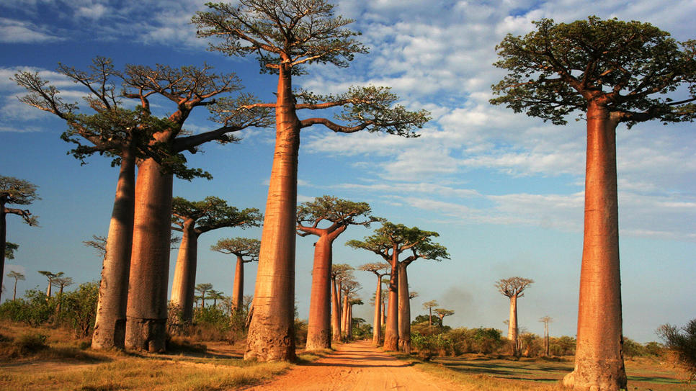
Binary Search Trees
Chris Piech
CS 106B
Lecture 20
Feb 24, 2016
CS 106B
2011

Slide 2

Announcements
Due March 2nd at 5pm
YEAH tomorrow at 5pm in braunAud

Slide 3

Mid Quarter Evaluations

Slide 4

Socrative
Room: 106BWIN16

Slide 5

Today’s Goal
Binary Search Trees
Review Under the Hood

Slide 6


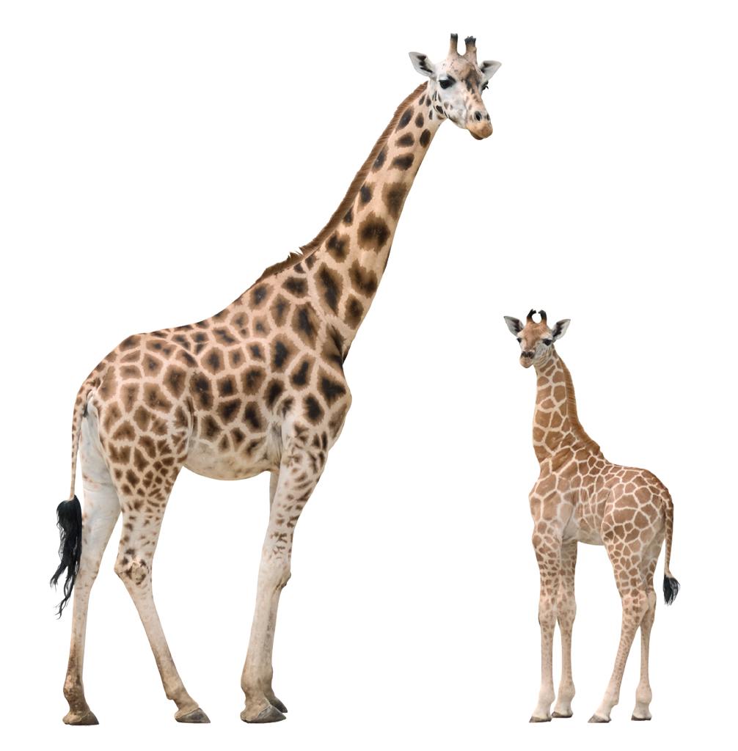

Today’s Route
Wednesday
Why?
Unlock Badge
BSTs
Review
Tree River

Slide 7
Binary Tree
struct Tree {
string value;
Tree * left;
Tree * right;
};
value
This is how a Binary Tree is defined

Slide 8
Pointers by Reference

Slide 9

Pointers by Reference
int main() {
Tree * root = NULL;
startTree(root);
}
void startTree(Tree * tree) {
tree = new Tree;
tree->label = “S”;
}
This is not going to do anything

Slide 10
Pointers by Reference
int main() {
Tree * root = NULL;
startTree(root);
}
void startTree(Tree * tree) {
tree = new Tree;
tree->label = “S”;
}
main
root
NULL

Slide 11
Pointers by Reference
int main() {
Tree * root = NULL;
startTree(root);
}
void startTree(Tree * tree) {
tree = new Tree;
tree->label = “S”;
}
main
root
NULL

Slide 12
Pointers by Reference
int main() {
Tree * root = NULL;
startTree(root);
}
void startTree(Tree * tree) {
tree = new Tree;
tree->label = “S”;
}
main
startTree
root
tree
NULL
NULL

Slide 13
Pointers by Reference
int main() {
Tree * root = NULL;
startTree(root);
}
void startTree(Tree * tree) {
tree = new Tree;
tree->label = “S”;
}
0x1234
main
startTree
root
tree
NULL
0x1234

Slide 14
Pointers by Reference
int main() {
Tree * root = NULL;
startTree(root);
}
void startTree(Tree * tree) {
tree = new Tree;
tree->label = “S”;
}
0x1234
main
startTree
S
root
tree
NULL
0x1234

Slide 15
Pointers by Reference
int main() {
Tree * root = NULL;
startTree(root);
}
void startTree(Tree * tree) {
tree = new Tree;
tree->label = “S”;
}
0x1234
main
S
root
NULL

Slide 16
Pointers by Reference
int main() {
Tree * root = NULL;
startTree(root);
}
void startTree(Tree * tree) {
tree = new Tree;
tree->label = “S”;
}
0x1234
main
S
root
NULL

Slide 17
Fix

Slide 18
Pointers by Reference
int main() {
Tree * root = NULL;
startTree(root);
}
void startTree(Tree * & tree) {
tree = new Tree;
tree->label = “S”;
}
This is the fix

Slide 19
Add Random Leaf

Slide 20
Add Random Leaf
S
X
M
Add a random node to this tree…

Slide 21
Add Random Leaf
S
X
M
G
… and you might get something like this

Slide 22
Add Random Leaf
void addRandomLeaf(Tree * tree) {
if(tree == NULL) {
tree = new Tree;
tree->value = randomChar();
return;
}
if(randomBool()) {
addRandomLeaf(tree->left);
} else {
addRandomLeaf(tree->right);
}
}

Slide 23
Add Random Leaf
void addRandomLeaf(Tree * & tree) {
if(tree == NULL) {
tree = new Tree;
tree->value = randomChar();
return;
}
if(randomBool()) {
addRandomLeaf(tree->left);
} else {
addRandomLeaf(tree->right);
}
}
Full trace in Monday’s code

Slide 24
Add Random Leaf
void addRandomLeaf(Tree * & tree) {
if(tree == NULL) {
tree = new Tree;
tree->value = randomChar();
return;
}
if(randomBool()) {
addRandomLeaf(tree->left);
} else {
addRandomLeaf(tree->right);
}
}
int main() {
Tree * root = NULL;
addRandomLeaf(root);
}

Slide 25
Pensive
Fruit?
no
yes
Banana?
Singer?
no
yes
DJ Khaled?
Beyonce?

Slide 26



Pensive
Fruit?
no
yes
Banana?
Singer?
no
yes
DJ Khaled?
Beyonce?

Slide 27
Today’s Route
Wednesday
Why?
Unlock Badge
BSTs
Review
Tree River

Slide 28
Today’s Route
Wednesday
Why?
Unlock Badge
BSTs
Review
Tree River

Slide 29
How does the Map/Set work?

Slide 30
Talked About the Others
Vector
Grid
HashMap
Stack
Queue
PQueue
HashSet
Map
Set

Slide 31
Talked About the Others
Vector
Can I play too?
Grid
HashMap
Stack
Queue
PQueue
HashSet
Map
Set

Slide 32
Talked About the Others
Vector
Grid
HashMap
Stack
Queue
PQueue
HashSet
Map
Set

Slide 33
How does the Map/Set work?

Slide 34
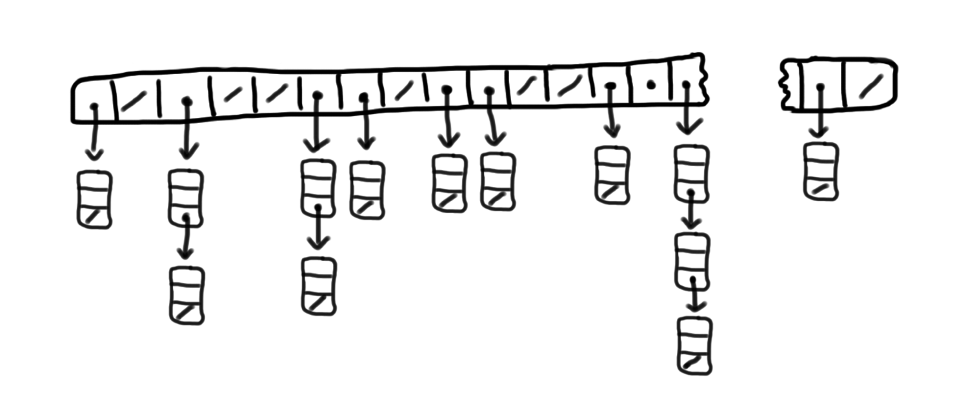



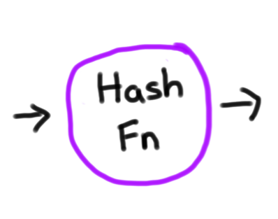
HashMap
HashMap:
7
8
9
10
11
12
13
14
49,999
0
1
2
3
4
5
6

Slide 35
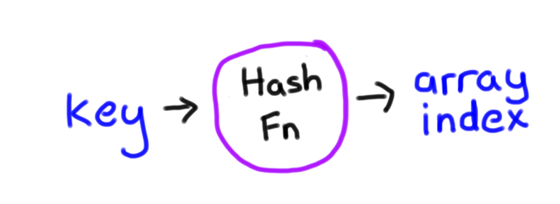


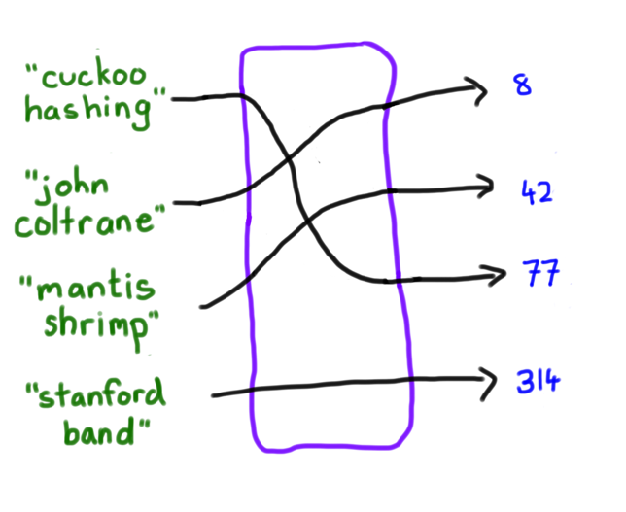

Hash Function
int hash(string key);
1. Consistent
2. Well Distributed
Hash Fn

Slide 36
Iteration
HashMap:
7
8
9
10
11
12
13
14
49,999
0
1
2
3
4
5
6

Slide 37
Iteration
HashMap:
7
8
9
10
11
12
13
14
49,999
0
1
2
3
4
5
6
Iterating over a map doesn’t return elements in sorted order

Slide 38
Iteration
HashMap:
7
8
9
10
11
12
13
14
49,999
0
1
2
3
4
5
6
Iterating over a map doesn’t return elements in sorted order

Slide 39
Iteration
HashMap:
7
8
9
10
11
12
13
14
49,999
0
1
2
3
4
5
6
Iterating over a map doesn’t return elements in sorted order

Slide 40
Iteration
HashMap:
7
8
9
10
11
12
13
14
49,999
0
1
2
3
4
5
6
Iterating over a map doesn’t return elements in sorted order

Slide 41
Iteration?
Hash Fn
Iterating over a map doesn’t return elements in sorted order

Slide 42
Iteration?
Hash Fn
Iterating over a map doesn’t return elements in sorted order

Slide 43
Iteration?
Hash Fn
Iterating over a map doesn’t return elements in sorted order

Slide 44
Iteration?
Hash Fn
Iterating over a map doesn’t return elements in sorted order

Slide 45
Iteration?
Hash Fn
Iterating over a map doesn’t return elements in sorted order

Slide 46
Maps and Sets Print in Order

Slide 47
[Suspense]

Slide 48
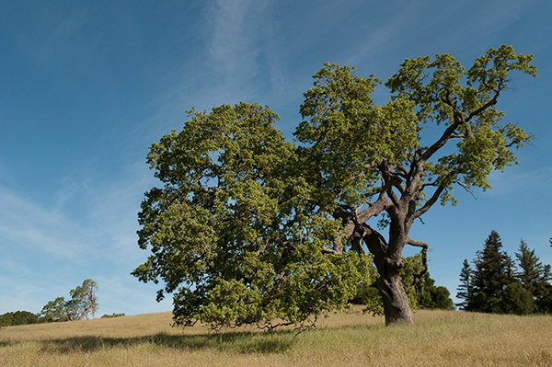

Slide 49
Binary Tree
Search

Slide 50
Binary Tree
Search
Binary Tree
key

Slide 51
Binary Tree
Search
Binary Tree
Search Tree
For a tree root:
Every node in root’s left subtree has a key < root’s key
Every node of root’s right subtree has a key > root’s key
All children of root are also binary search trees
key

Slide 52
Binary Search Tree
root
55
29
87
-3
42
60
91
What makes a tree a Binary Search Tree?

Slide 53
Binary Search Tree
root
55
29
87
-3
42
60
91
Every node in root’s left subtree has a key < root’s key

Slide 54
Binary Search Tree
root
55
29
87
-3
42
60
91
Every node in root’s right subtree has a key > root’s key

Slide 55
Binary Search Tree
root
55
29
87
-3
42
60
91
All children of root are also binary search trees.

Slide 56
Like a Pensive
Except each question is “>”
Fruit?
no
yes
Banana?
Singer?
no
yes
DJ Khaled?
Beyonce?

Slide 57

BST examples
Q: How many of the trees shown are legal binary search trees?
A. none
B. one
C. two
D. three
E. four or more
(1)
m
(2)
-5
(3)
42
(4)
8
g
q
-1
-7
5
11
b
k
x
2
7
10
18
(5)
7.2
e
4
20
1.9
9.6
18
8.1
21.3

Slide 58
BST examples
Q: How many of the trees shown are legal binary search trees?
A. none
B. one
C. two
D. three
E. four or more
(1)
m
(2)
-5
(3)
42
(4)
8
g
q
-1
-7
5
11
b
k
x
2
7
10
18
(5)
7.2
e
4
20
1.9
9.6
18
8.1
21.3

Slide 59
Searching a BST
1. Try searching for the value 31, then 6 from the root
root
18
12
35
4
15
22
58
-2
7
13
16
19
31
40
87

Slide 60
Describe your algorithm

Slide 61
Searching a BST
2. Describe your algorithm
root
18
12
35
4
15
22
58
-2
7
13
16
19
31
40
87

Slide 62
Searching a BST
Searching for the value 31 from the root
root
18

Slide 63
Searching a BST
Searching for the value 31 from the root
root
18
35

Slide 64
Searching a BST
Searching for the value 31 from the root
root
18
35
22

Slide 65
Searching a BST
Searching for the value 31 from the root
root
18
35
22
31

Slide 66
Searching a BST
Searching for the value 31 from the root
root
18
35
22
31

Slide 67
Contains Algorithm
bool contains(Tree * tree, int value) {
// you hit a leaf. Only happens if no value
if(tree == NULL) return false;
// you found it! Yes tree contains value.
if(tree->value == value) return true;
if(value < tree->value) {
// if value is less, recurse on left.
return contains(tree->left);
} else {
// if value is greater, recurse on right.
return contains(tree->right);
}
}

Slide 68
Big O?

Slide 69
Searching a BST
3. What’s the maximum number of nodes to check?
root
18
12
35
4
15
22
58
-2
7
13
16
19
31
40
87

Slide 70
Searching a BST
3. What’s the maximum number of nodes to check?
root
18
12
35
Tree height
4
15
22
58
-2
7
13
16
19
31
40
87

Slide 71
Contains Big O
* Assuming the tree is balanced

Slide 72
Unbalance
root
18
35
12
4
-2
-8
This is what an unbalanced tree looks like.

Slide 73
Add
Choice 1
Choice 2
void add(Tree * tree, int value) {
if(tree == NULL) {
tree = new Tree;
tree->value = value;
tree->left = NULL;
tree->right = NULL;
} else {
if(value < tree->value) {
add(tree->left, value);
} else if(value > tree->value){
add(tree->right, value);
}
}
}
void add(Tree * & tree, int value) {
if(tree == NULL) {
tree = new Tree;
tree->value = value;
tree->left = NULL;
tree->right = NULL;
} else {
if(value < tree->value) {
add(tree->left, value);
} else if(value > tree->value){
add(tree->right, value);
}
}
}
Which one is better?

Slide 74
Add
Choice 1
Choice 2
void add(Tree * tree, int value) {
if(tree == NULL) {
tree = new Tree;
tree->value = value;
tree->left = NULL;
tree->right = NULL;
} else {
if(value < tree->value) {
add(tree->left, value);
} else if(value > tree->value){
add(tree->right, value);
}
}
}
void add(Tree * & tree, int value) {
if(tree == NULL) {
tree = new Tree;
tree->value = value;
tree->left = NULL;
tree->right = NULL;
} else {
if(value < tree->value) {
add(tree->left, value);
} else if(value > tree->value){
add(tree->right, value);
}
}
}
Which one is better?

Slide 75

Balanced Add and Remove
Big O?
Leonidas Guibas

Slide 76
Note: Beyond Scope

Slide 77
Illustrating AVL
H
He
Li
Be
B
C

Slide 78
Illustrating AVL
H
H
=
He
Li
Be
B
C

Slide 79
Illustrating AVL
H
H
=
He
Li
Be
B
C

Slide 80
Illustrating AVL
H
H
+
He
Li
He
=
Be
B
C

Slide 81
Illustrating AVL
H
H
+
He
Li
He
=
Be
B
C

Slide 82
Illustrating AVL
H
H
++
He
Li
He
+
Be
B
Li
=
C

Slide 83
Illustrating AVL
H
=
H
++
He
Rotate left
Li
=
He
+
Be
B
Li
=
C

Slide 84
Illustrating AVL
H
=
He
He
Li
H
=
Li
=
Be
B
C

Slide 85
Illustrating AVL
H
–
He
He
Li
H
–
Li
=
Be
B
=
Be
C

Slide 86
Illustrating AVL
H
–
He
He
Li
H
–
Li
=
Be
B
=
Be
C

Slide 87
Illustrating AVL
H
–
He
He
Li
H
– –
Li
=
Be
B
–
Be
C
B
=

Slide 88
Illustrating AVL
H
–
He
He
Li
– –
=
=
H
=
Li
Be
Be
B
–
=
=
=
Rotate right
Be
H
B
C
B
=

Slide 89
Illustrating AVL
H
–
He
He
Li
Be
=
Li
=
Be
B
=
=
B
H
C

Slide 90
Illustrating AVL
H
– –
He
He
Li
Be
+
Li
=
Be
B
=
–
B
H
C
C
=

Slide 91
Illustrating AVL
H
– –
He
He
Li
– –
=
H
+
Li
Be
Be
B
Be
=
–
B
=
H
Rotate left
C
=
=
B
C
=
C

Slide 92
Illustrating AVL
H
– –
He
=
Rotate right
He
Li
+
–
H
– –
Li
=
Be
B
Be
=
C
B
=
C
=

Slide 93
Back to Scope

Slide 94
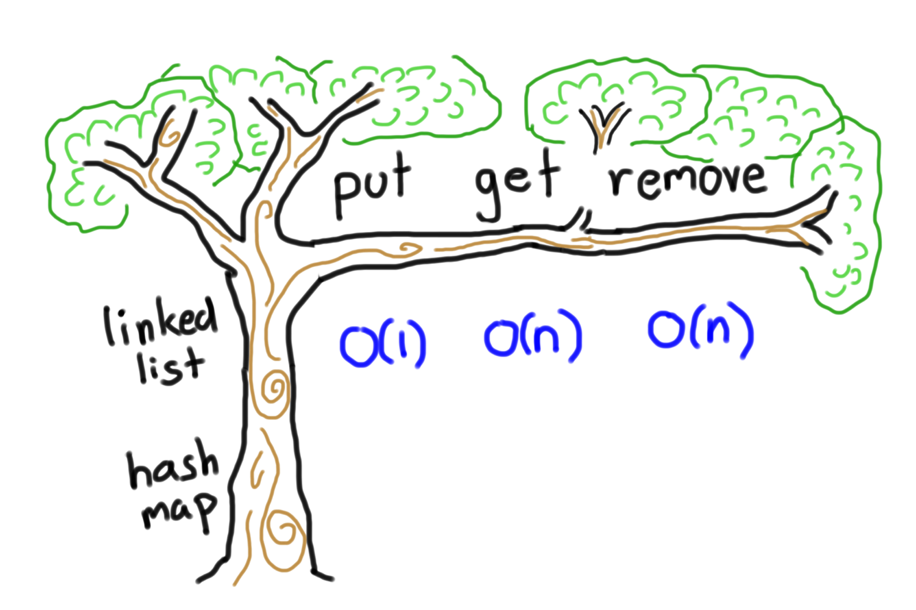
Binary Search Tree Big O
add
contains
remove
Set
HashSet
Hash Map is faster…

Slide 95
Log n
Lets say n is 1 billion
..But not by much

Slide 96
How does the Map/Set work?

Slide 97
Maps and Sets Print in Order

Slide 98
Iteration?
root
18
12
35
4
15
22
58
-2
7
13
16
19
31
40
87

Slide 99
Tree Traversal
void preOrder(Tree * tree) {
if(tree == NULL) return;
cout<<tree->value<<” “;
preOrder(tree->left);
preOrder(tree->right);
}
void inOrder(Tree * tree) {
if(tree == NULL) return;
inOrder(tree->left);
cout<<tree->value<<” “;
inOrder(tree->right);
}
Void postOrder(Tree * tree) {
if(tree == NULL) return;
postOrder(tree->left);
postOrder(tree->right);
cout<<tree->value<<” “;
}
root
18
12
35
4
15
22
58
-2
7
13
16
19
31
40
87

Slide 100
Tree Traversal
void preOrder(Tree * tree) {
if(tree == NULL) return;
cout<<tree->value<<” “;
preOrder(tree->left);
preOrder(tree->right);
}
void inOrder(Tree * tree) {
if(tree == NULL) return;
inOrder(tree->left);
cout<<tree->value<<” “;
inOrder(tree->right);
}
void postOrder(Tree * tree) {
if(tree == NULL) return;
postOrder(tree->left);
postOrder(tree->right);
cout<<tree->value<<” “;
}
root
18
12
35
4
15
22
58
-2
7
13
16
19
31
40
87

Slide 101
Tree Traversal
void preOrder(Tree * tree) {
if(tree == NULL) return;
cout<<tree->value<<” “;
preOrder(tree->left);
preOrder(tree->right);
}
void inOrder(Tree * tree) {
if(tree == NULL) return;
inOrder(tree->left);
cout<<tree->value<<” “;
inOrder(tree->right);
}
void postOrder(Tree * tree) {
if(tree == NULL) return;
postOrder(tree->left);
postOrder(tree->right);
cout<<tree->value<<” “;
}
root
18
12
35
4
15
22
58
-2
7
13
16
19
31
40
87

Slide 102
Tree Traversal
void preOrder(Tree * tree) {
if(tree == NULL) return;
cout<<tree->value<<” “;
preOrder(tree->left);
preOrder(tree->right);
}
void inOrder(Tree * tree) {
if(tree == NULL) return;
inOrder(tree->left);
cout<<tree->value<<” “;
inOrder(tree->right);
}
void postOrder(Tree * tree) {
if(tree == NULL) return;
postOrder(tree->left);
postOrder(tree->right);
cout<<tree->value<<” “;
}
root
18
12
35
4
15
22
58
-2
7
13
16
19
31
40
87

Slide 103
Tree Traversal
void preOrder(Tree * tree) {
if(tree == NULL) return;
cout<<tree->value<<” “;
preOrder(tree->left);
preOrder(tree->right);
}
void inOrder(Tree * tree) {
if(tree == NULL) return;
inOrder(tree->left);
cout<<tree->value<<” “;
inOrder(tree->right);
}
void postOrder(Tree * tree) {
if(tree == NULL) return;
postOrder(tree->left);
postOrder(tree->right);
cout<<tree->value<<” “;
}
root
18
12
35
4
15
22
58
-2
7
13
16
19
31
40
87

Slide 104
Tree Traversal
void preOrder(Tree * tree) {
if(tree == NULL) return;
cout<<tree->value<<” “;
preOrder(tree->left);
preOrder(tree->right);
}
void inOrder(Tree * tree) {
if(tree == NULL) return;
inOrder(tree->left);
cout<<tree->value<<” “;
inOrder(tree->right);
}
void postOrder(Tree * tree) {
if(tree == NULL) return;
postOrder(tree->left);
postOrder(tree->right);
cout<<tree->value<<” “;
}
root
18
12
35
4
15
22
58
-2
7
13
16
19
31
40
87

Slide 105

Tree Traversal
void preOrder(Tree * tree) {
if(tree == NULL) return;
cout<<tree->value<<” “;
preOrder(tree->left);
preOrder(tree->right);
}
void inOrder(Tree * tree) {
if(tree == NULL) return;
inOrder(tree->left);
cout<<tree->value<<” “;
inOrder(tree->right);
}
void postOrder(Tree * tree) {
if(tree == NULL) return;
postOrder(tree->left);
postOrder(tree->right);
cout<<tree->value<<” “;
}
root
18
12
35
4
15
22
58
-2
7
13
16
19
31
40
87

Slide 106
Today’s Route
Wednesday
Why?
Unlock Badge
BSTs
Review
Tree River

Slide 107
Today’s Route
Wednesday
Why?
Unlock Badge
BSTs
Review
Tree River

Slide 108
Where Am I?

Slide 109
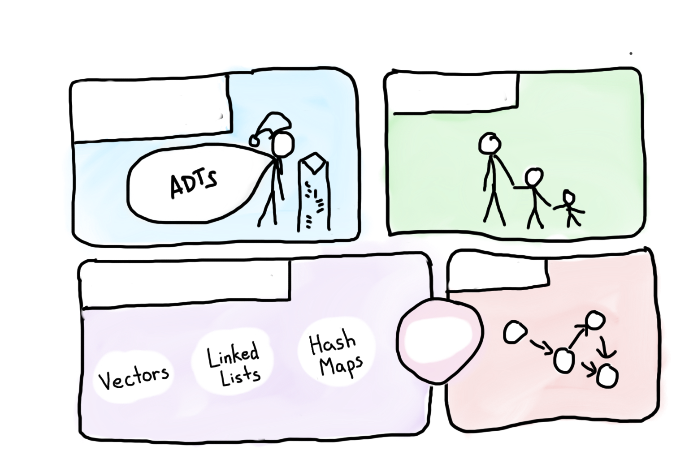
Course Syllabus
Intro to Abstractions
Recursion
Graphs
Under the Hood
Trees
You are here

Slide 110


Building Blocks
Pointers
Classes / Structs
GImage * image =
new GImage(“cat.png”);
0x124134
image
Blueprint for a new variable type

Slide 111
Vector

Slide 112
Vector
137
42
element
array
allocated
length
2
logical
length
2

Slide 113
Actual Vector
137
42
271
element
array
allocated
length
4
logical
length
3

Slide 114
Actual Vector
137
42
271
828
element
array
allocated
length
4
logical
length
4

Slide 115
Vector
137
42
271
828
element
array
allocated
length
4
logical
length
4

Slide 116
Vector
137
42
271
828
182
element
array
allocated
length
8
logical
length
5

Slide 117
Stack

Slide 118
Stack
Node *
data
8
9

Slide 119
Stack Push
push(7);
Node *
data
8
9
7

Slide 120
Stack Pop
pop();
Node *
data
8
9
int return
7
7

Slide 121
Queue

Slide 122
Queue
Node *
tail
Node *
head
3
2
1

Slide 123
Queue Enqueue
Node *
tail
Node *
head
4
3
2
1

Slide 124
Queue Dequeue
Node *
tail
Node *
head
4
3
2
1

Slide 125
Queue Dequeue
Node *
tail
Node *
head
4
3
2

Slide 126
HashMap / HashSet

Slide 127
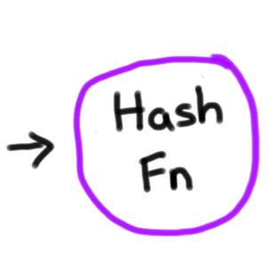
HashMap
Wikipedia:
7
8
9
10
11
12
13
14
49,999
0
1
2
3
4
5
6

Slide 128
HashMap
Wikipedia:
7
8
9
10
11
12
13
14
49,999
0
1
2
3
4
5
6

Slide 129

HashMap
Wikipedia:
7
8
9
10
11
12
13
14
49,999
0
1
2
3
4
5
6

Slide 130
HashMap
Wikipedia:
7
8
9
10
11
12
13
14
49,999
0
1
2
3
4
5
6

Slide 131
HashMap
Wikipedia:
7
8
9
10
11
12
13
14
49,999
0
1
2
3
4
5
6

Slide 132
HashMap
7
8
9
10
11
12
13
14
49,999
0
1
2
3
4
5
6

Slide 133
PQueue

Slide 134
Priority Queue
Pqueue Tree
Heap Ordered: Every branch takes you to a “greater” node.
Binary: Every node has at most two children.
Complete: There are no “gaps” in the tree.
10
20
80
This is the next spot to fill
40
60
85
99
50
76
65

Slide 135
Sets + Maps

Slide 136
Sets and Maps
root
Binary Search Tree
18
12
35
4
15
22
58
-2
7
13
16
19
31
40
87

Slide 137
That’s all of them

Slide 138
Main CS Collections
Vector
Grid
HashMap
Stack
Queue
PQueue
HashSet
Map
Set

Slide 139

Main CS Collections
Vector
Grid
HashMap
Stack
Queue
Saw under the hood of the main CS collections
PQueue
HashSet
Map
Set

Slide 140
Today’s Route
Wednesday
Why?
Unlock Badge
BSTs
Review
Tree River

Slide 141
Today’s Route
Wednesday
Why?
Unlock Badge
BSTs
Review
Tree River

Slide 142
Great Ideas

Slide 143
Ok folks…

Slide 144
Let’s Talk about YikYak

Slide 145
How do you think its implemented?

Slide 146

YikYak
Lol

Slide 147
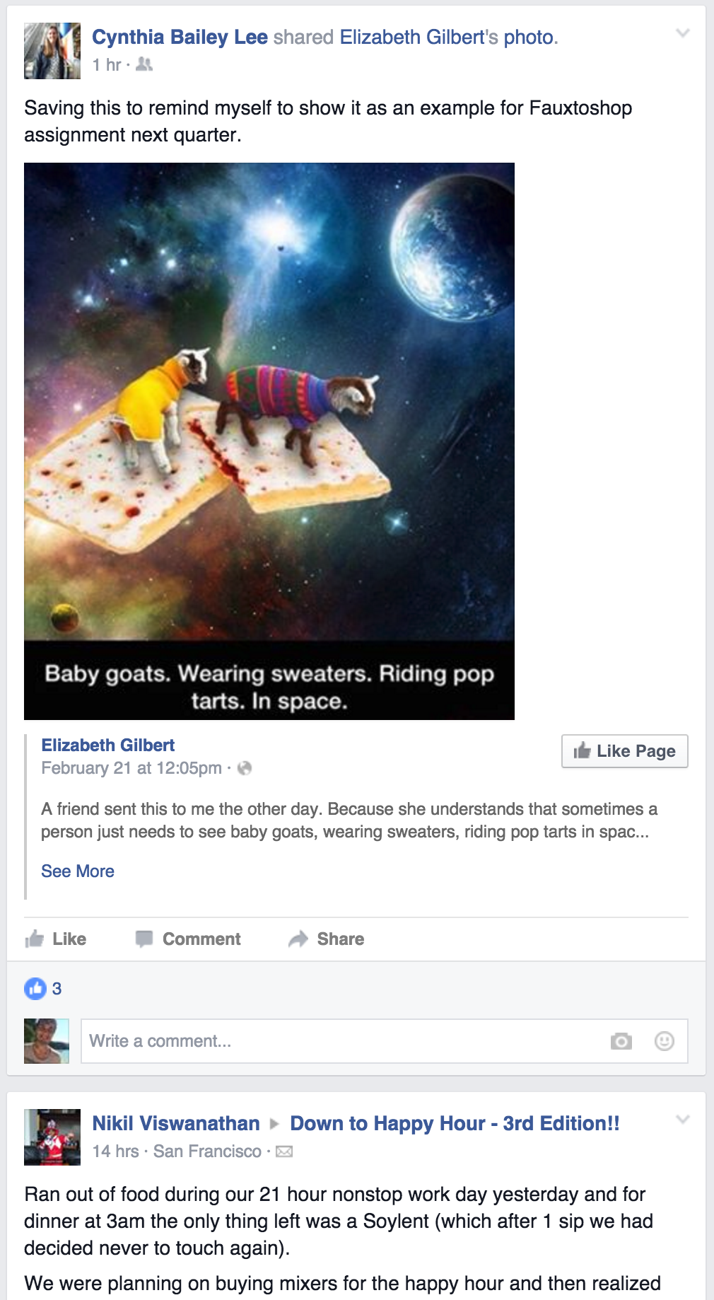
Newsfeed?

Slide 148
Newsfeed?
PriorityQueue? Need to iterate many times
Set? Duplicate priorities

Slide 149
Priority Based with Iteration

Slide 150
BST that Allows Duplicates?
root
18
12
35
4
15
22
57
-2
7
13
16
19
31
40
87

Slide 151

Linked List?
Node *
head
90
87

Slide 152
Linked List?
Display 1
Display 2
Node *
head
90
87

Slide 153
Linked List?
Display 1
Display 2
Node *
head
90
87

Slide 154
Linked List?
Display 1
Display 2
Node *
head
90
87
Node *
tail

Slide 155
Yakray
Display 1
Display 2
Node *
head
90
87
Node *
tail

Slide 156
Happy with that

Slide 157
Today’s Route
Wednesday
Why?
Unlock Badge
BSTs
Review
Tree River

Slide 158
Today’s Route
Wednesday
Why?
Unlock Badge
BSTs
Review
Tree River

Slide 159
Today’s Goal
Binary Search Trees
Review Under the Hood

Slide 160
Course Syllabus
Intro to Abstractions
Recursion
Graphs
Under the Hood
Trees
You are here

Slide 161
Course Syllabus
Intro to Abstractions
Recursion
Graphs
Under the Hood
Trees
You are here

Slide 162
[Drops mic, walk away]

Slide 163
Incase of extra time, pick up mic

Slide 164
Supervised Machine Learning
High dimensional
vector
Label
Not on Final

Slide 165


Supervised Machine Learning
High dimensional
vector
Label
Not on Final

Slide 166
Supervised Machine Learning
Training
High dimensional
vector
Label
Testing
High dimensional
vector
?
Not on Final

Slide 167
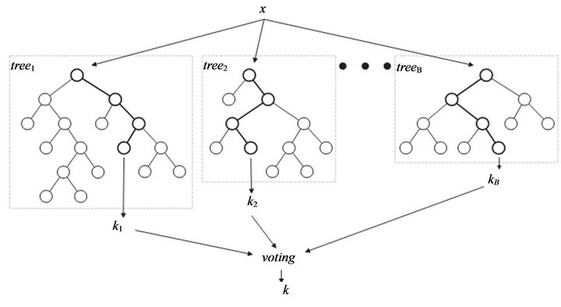

Random Forest
High dimensional vector
Not on Final

Slide 168
Random Forest
High dimensional vector
Not on Final
Label

